Slide 1
Assignment 1
Name : Aniket Balasaheb Kshirsagar
Div: SE_AIDS
Roll no : s1411033
Sub : FDS Lab

Slide 2
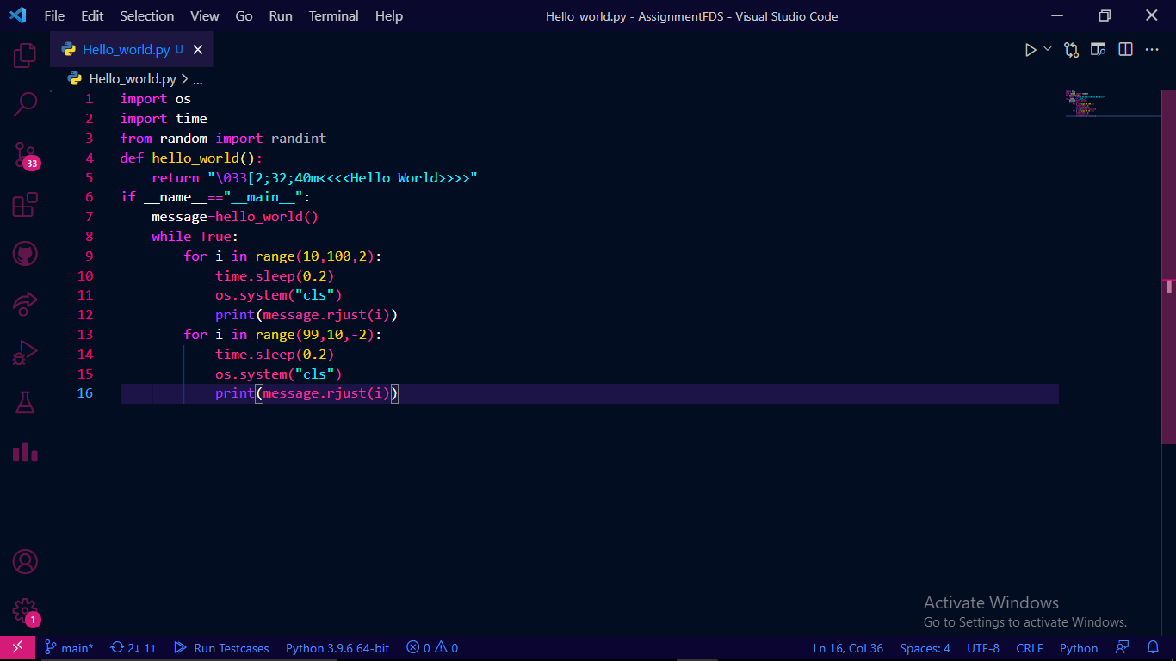
Project 1-Hello_world program *code

Slide 3
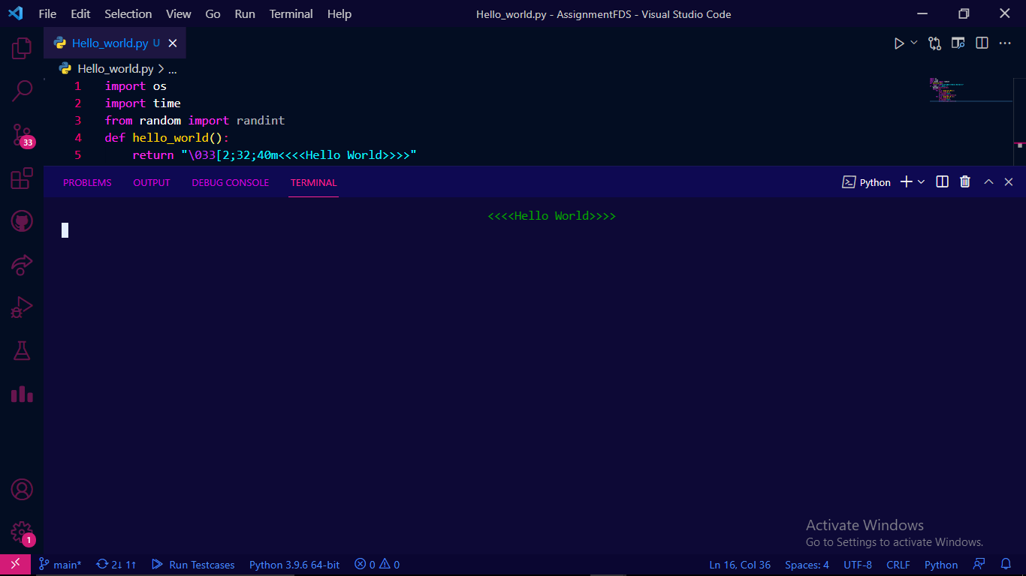
Project 1-Hello_world program *result

Slide 4
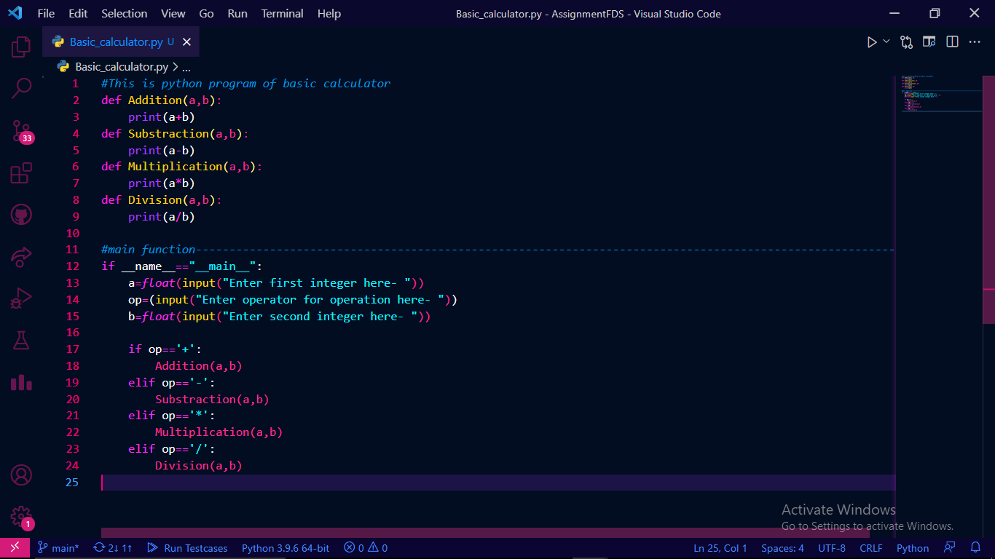
Project 2 – Basic_Calculator Program *code

Slide 5
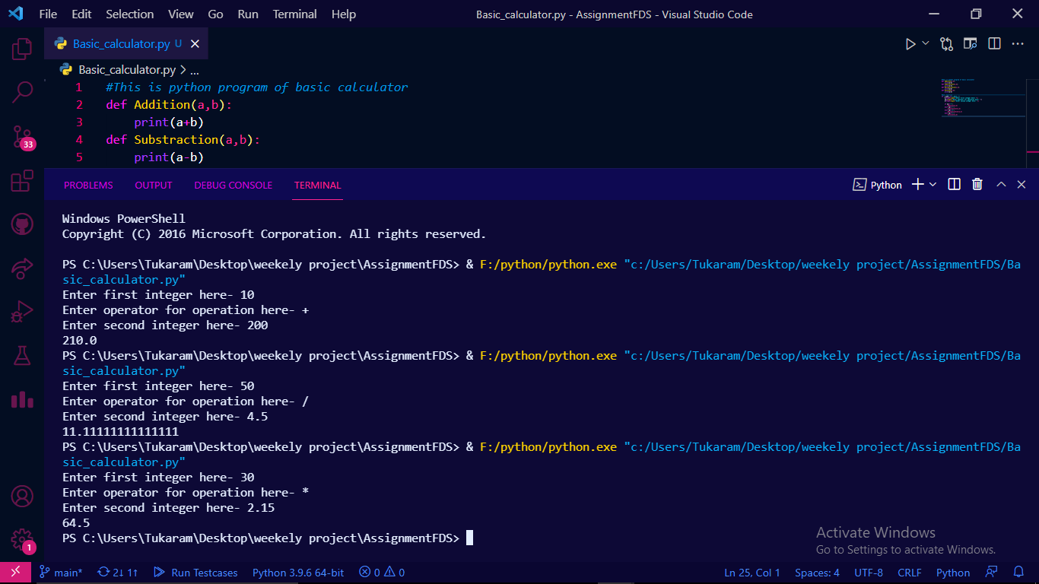
Project 2 – Basic_Calculator Program *result

Slide 6
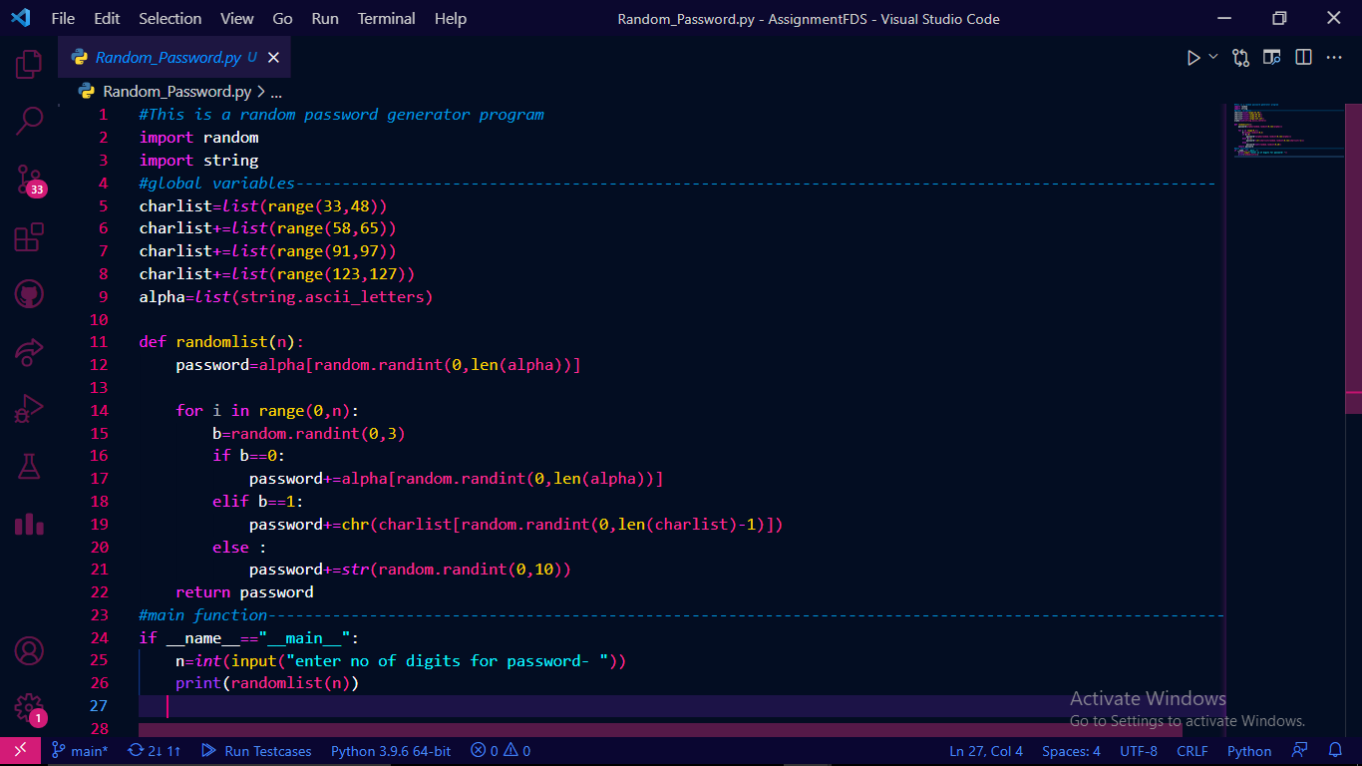
Project 3 – Random_Password Program *code

Slide 7
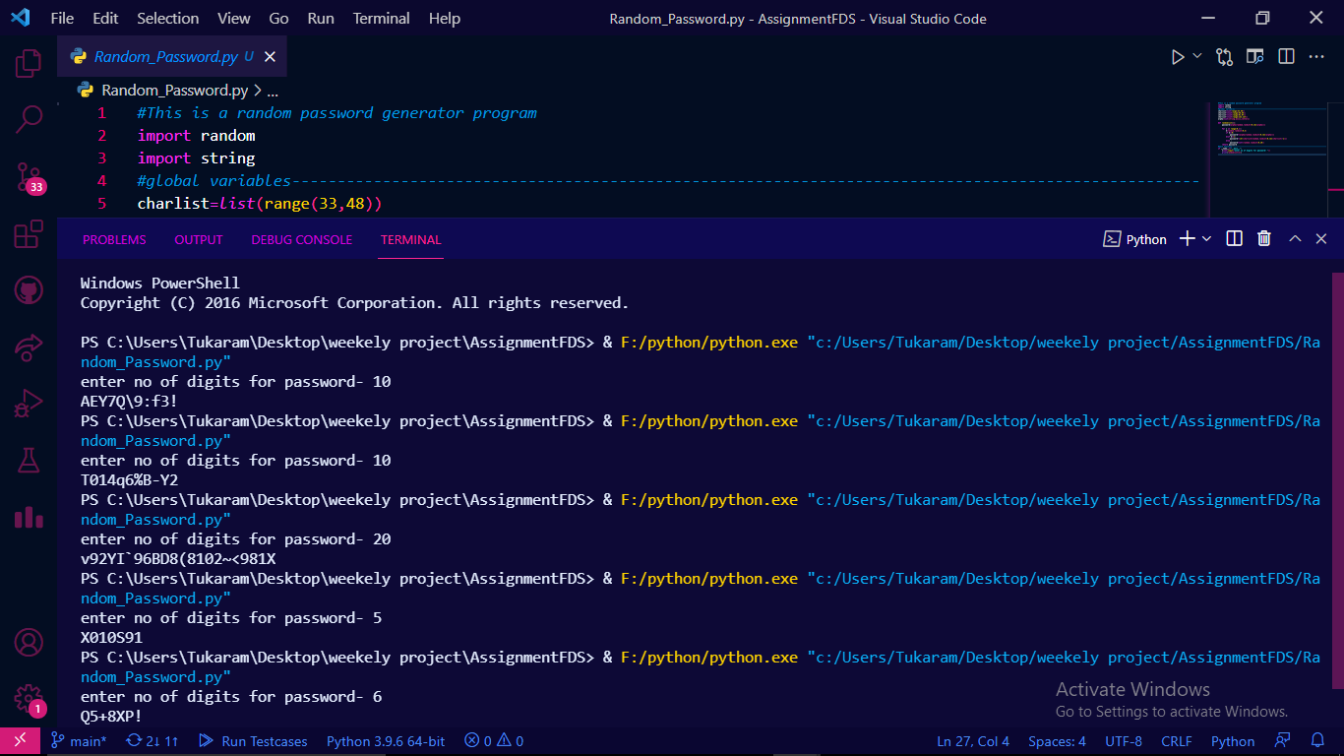
Project 3 – Random_Password Program *result

Slide 8
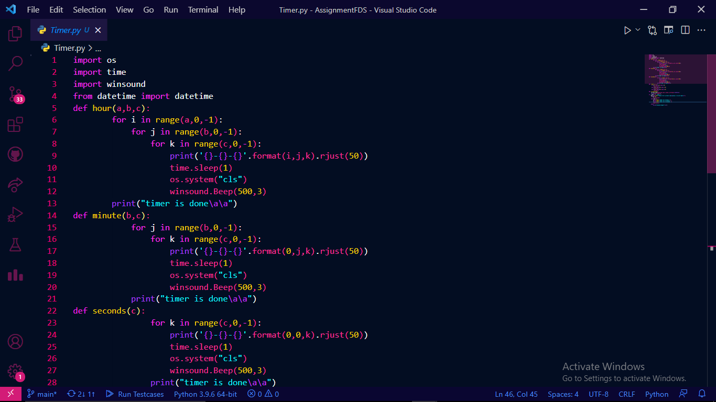
Project 4 – Timer Program *code1

Slide 9
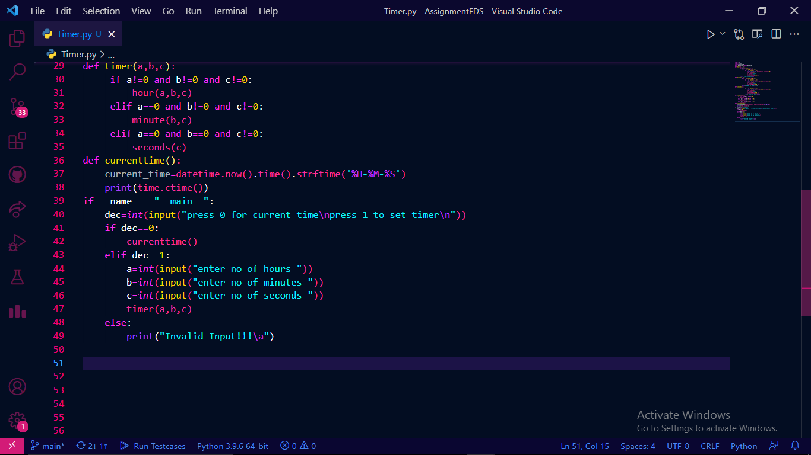
Project 4 – Timer Program *code2

Slide 10
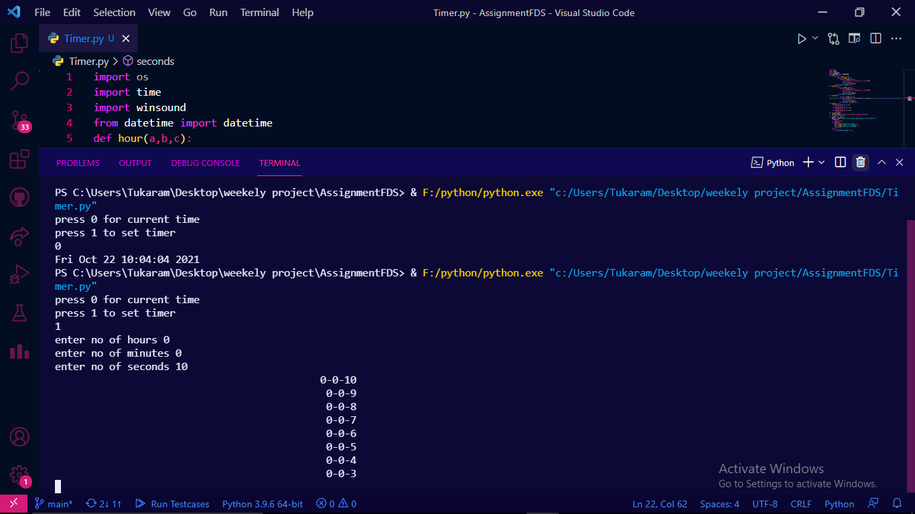
Project 4 – Timer Program *result

Slide 11
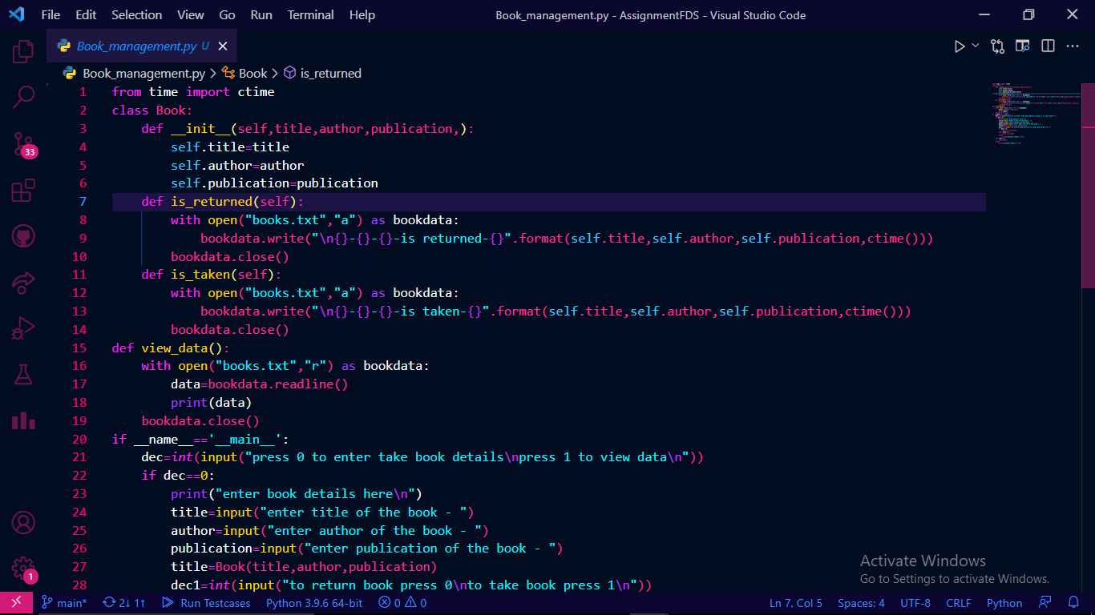
Project 5 – library_management Program *code1

Slide 12
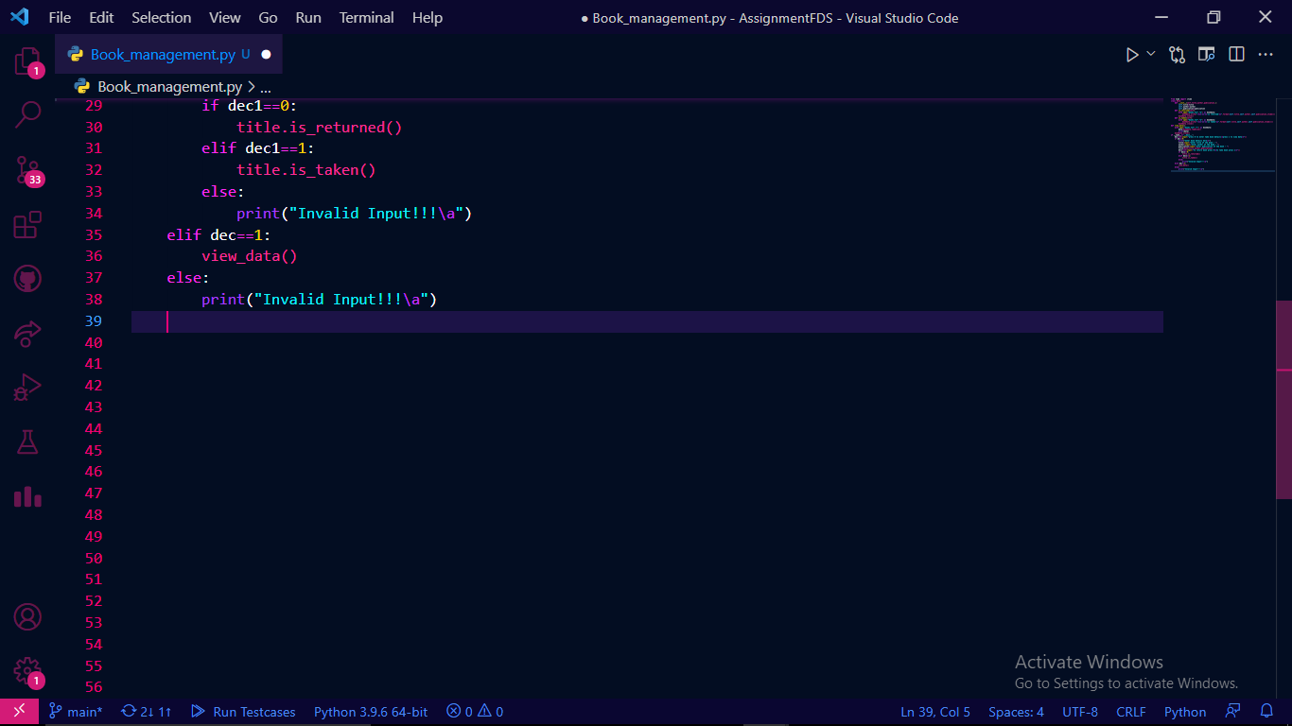
Project 5 – library_management Program *code2

Slide 13
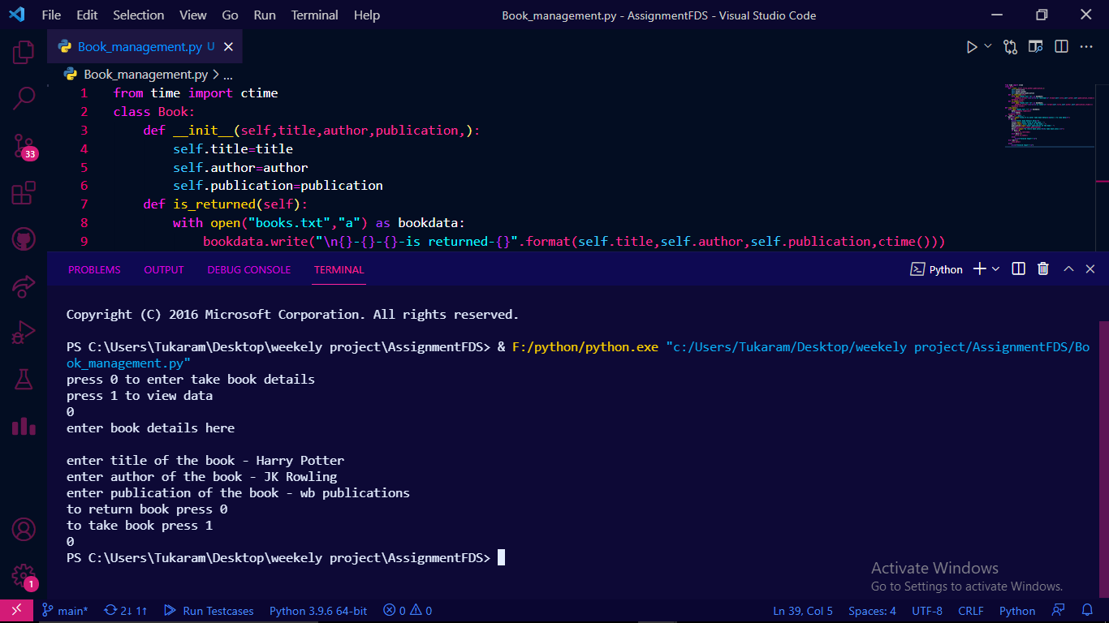
Project 5 – library_management Program *result1

Slide 14
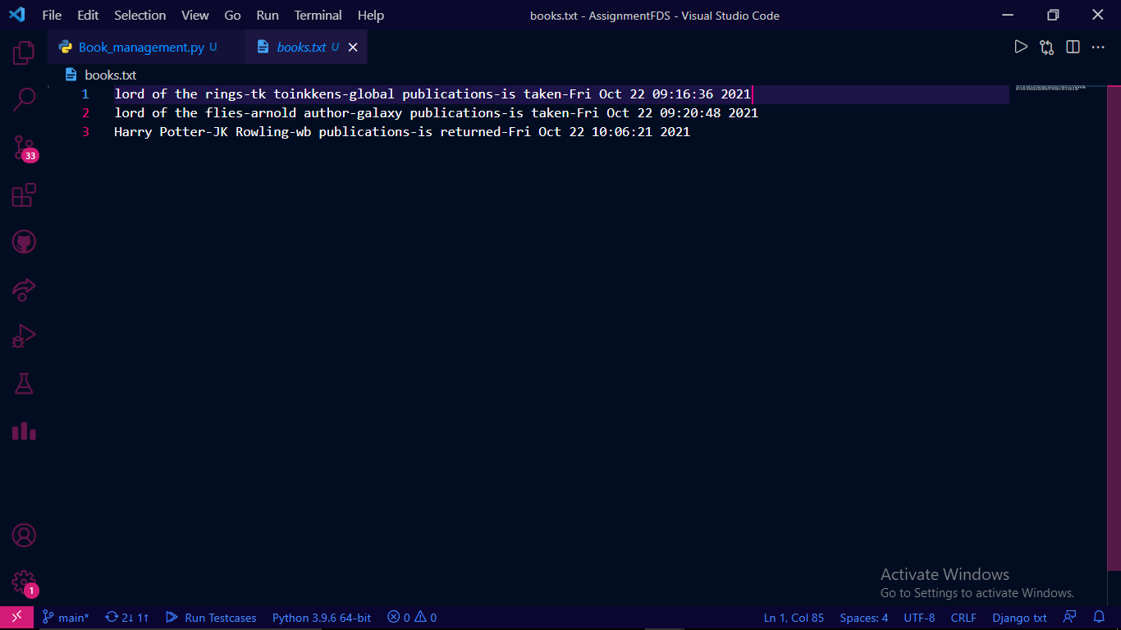
Project 5 – library_management Program *result2

